Slide 1
Are You An
Ignorant
Victim…
Ignorance is NOT bliss

Slide 2
Is French Fries good for health? Why ?
Who is responsible for your good health?
Is French Fries good for health? Why ?
They said mobile radiation is bad !! How to find whether I am in safe exposure level or not?
What are the worst ailments we may get?
Why people say “Don’t use plastics”?
What is the probability !!!
Which is the best tooth past? How to find them..
Are my children safe and healthy.. How to choose good stuff them?
Do I really know, what I am eating, drinking and breathing?

Slide 3
Story time
what happened when we started asking these questions and try to find some answers….

Slide 4
Every month in CHENNAI
500+
new cancer patients register in hospitals
15+
are children of age 0 to 14
Notes:
Presentations are a powerful communication medium.

Slide 5
Why?
More than 40% of children get
Leukemias
(Blood & bone marrow related)
Male children are affected more with childhood cancer.
More than 15% of children get
Lymphomas
(Blood related)
Notes:
Presentations are a powerful communication medium.

Slide 6
Globally, about 19% of all cancers were estimated to be attributable to the environment, resulting 1.3 million deaths each year.
Globally, about 19% of all cancers were estimated to be attributable to the environment, resulting 1.3 million deaths each year – WHO (publication: preventing decease through healthy environment)
Notes:
Presentations are a powerful communication medium.

Slide 7
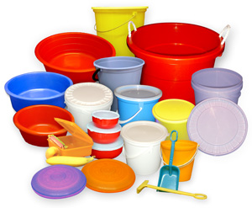




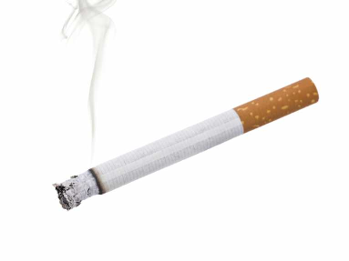



Plastic usage (Harmful Phthalates)
Chemicals in cosmetics
Processed food
(carcinogens)
Exposure to carcinogens (consumables, food, air)
Alcoholic beverages
Tobacco (smoking & non- smoking)
Fried food in saturated oils. Packed chips, snacks etc.,
Safe, non-toxic, good Food and good lifestyle
Food that leads to obesity
Junk food
(pizza, french fry etc)
Notes:
Presentations are a powerful communication medium.

Slide 8







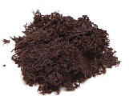
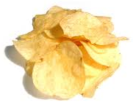



What causes cancer?
Globally, about 19% of all cancers were estimated to be attributable to the environment, resulting 1.3 million deaths each year.
Obesity
Carcinogen consumption
(cancer creating chemicals)
Lifestyle
Consumables
Alcohol & Tobacco
Food
Notes:
Presentations are a powerful communication medium.

Slide 9


Plastics – Where & how to avoid?
Globally, about 19% of all cancers were estimated to be attributable to the environment, resulting 1.3 million deaths each year.
Then.. How to choose good and bad
BAD
GOOD
Notes:
Presentations are a powerful communication medium.

Slide 10
Plastics – Where & how to avoid?
Globally, about 19% of all cancers were estimated to be attributable to the environment, resulting 1.3 million deaths each year.
There is NOTHING called as
SAFE PLASTIC….
Notes:
Presentations are a powerful communication medium.

Slide 11
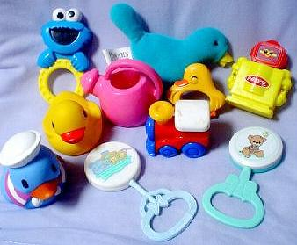
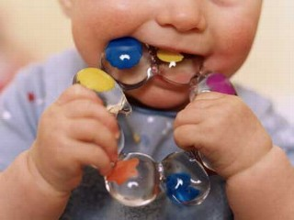
Plastics
Globally, about 19% of all cancers were estimated to be attributable to the environment, resulting 1.3 million deaths each year.
Notes:
Presentations are a powerful communication medium.

Slide 12
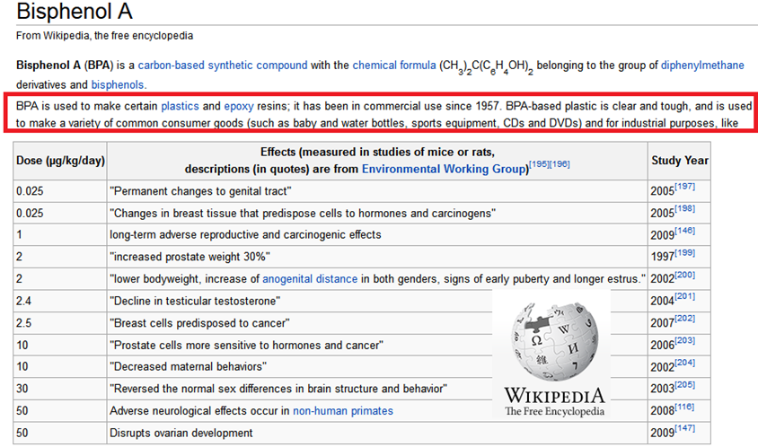
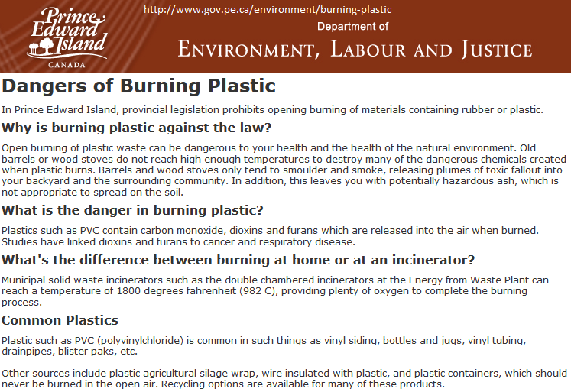
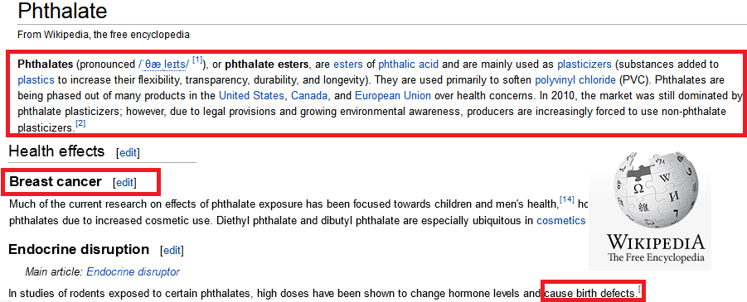

Plastics – Why to avoid?
Globally, about 19% of all cancers were estimated to be attributable to the environment, resulting 1.3 million deaths each year.
Notes:
Presentations are a powerful communication medium.

Slide 13
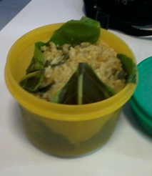
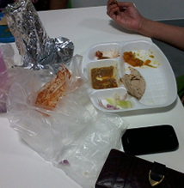
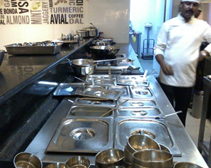
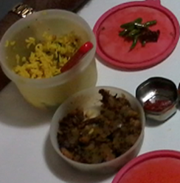
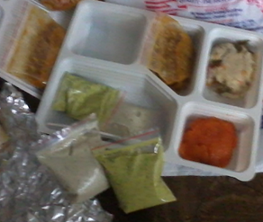

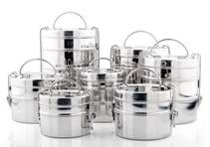
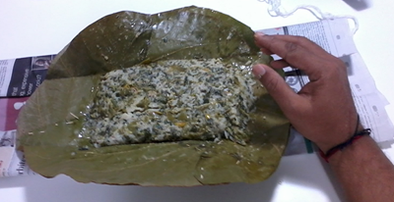
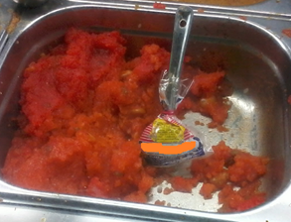
Plastics – Where & how to avoid?
Globally, about 19% of all cancers were estimated to be attributable to the environment, resulting 1.3 million deaths each year.
Notes:
Presentations are a powerful communication medium.

Slide 14
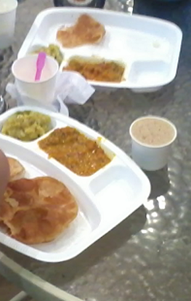
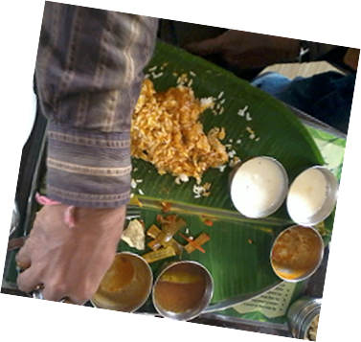
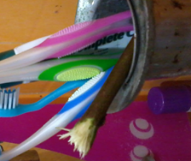
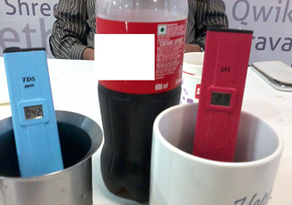
Plastics
Globally, about 19% of all cancers were estimated to be attributable to the environment, resulting 1.3 million deaths each year.
Notes:
Presentations are a powerful communication medium.

Slide 15
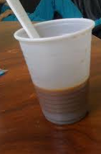

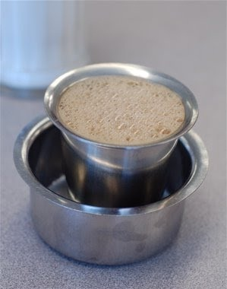


Slide 16
Plastics – Where & how to avoid?
Globally, about 19% of all cancers were estimated to be attributable to the environment, resulting 1.3 million deaths each year.
Why French (potato) Fries are not good for health
Notes:
Presentations are a powerful communication medium.

Slide 17

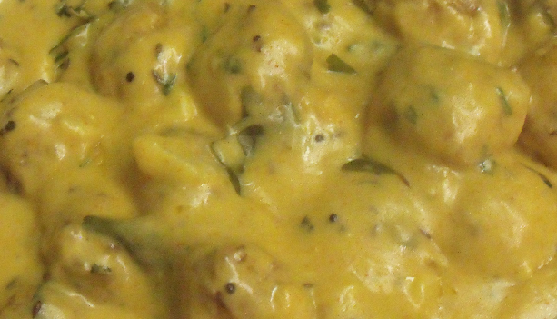
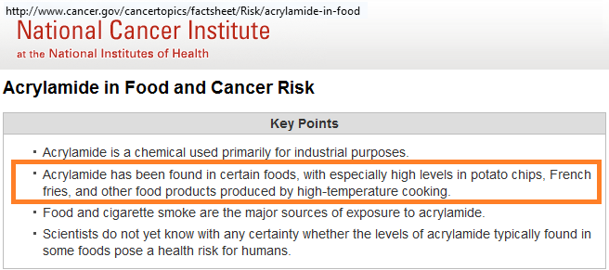
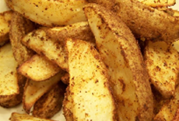
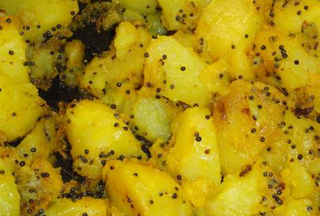
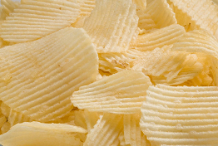

Eat
Globally, about 19% of all cancers were estimated to be attributable to the environment, resulting 1.3 million deaths each year.
Notes:
Presentations are a powerful communication medium.

Slide 18
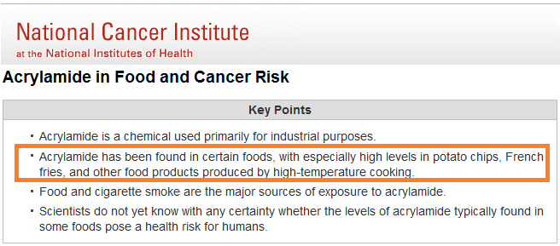
Acrylamide
Globally, about 19% of all cancers were estimated to be attributable to the environment, resulting 1.3 million deaths each year.
Notes:
Presentations are a powerful communication medium.

Slide 19
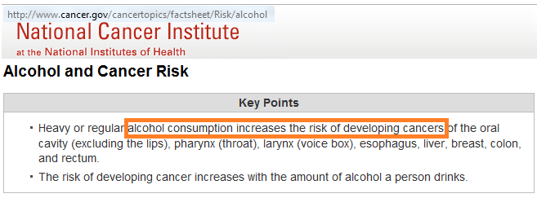
Alcohol
Globally, about 19% of all cancers were estimated to be attributable to the environment, resulting 1.3 million deaths each year.
Notes:
Presentations are a powerful communication medium.

Slide 20
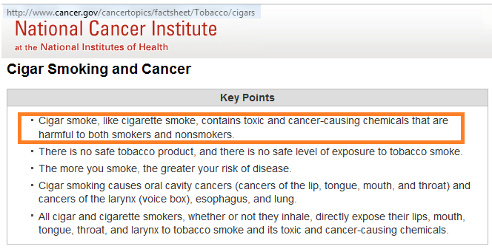
Tobacco (smoking)
Globally, about 19% of all cancers were estimated to be attributable to the environment, resulting 1.3 million deaths each year.
Notes:
Presentations are a powerful communication medium.

Slide 21
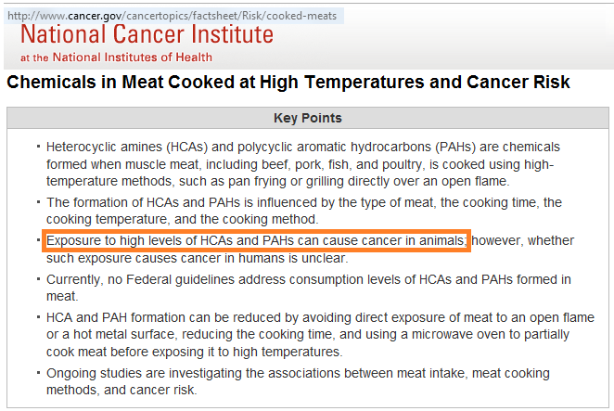
Cooking in High Temperature
Globally, about 19% of all cancers were estimated to be attributable to the environment, resulting 1.3 million deaths each year.
Notes:
Presentations are a powerful communication medium.

Slide 22
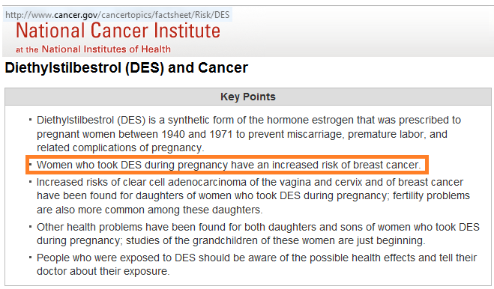
DES increases risk of breast cancer
Globally, about 19% of all cancers were estimated to be attributable to the environment, resulting 1.3 million deaths each year.
Notes:
Presentations are a powerful communication medium.

Slide 23
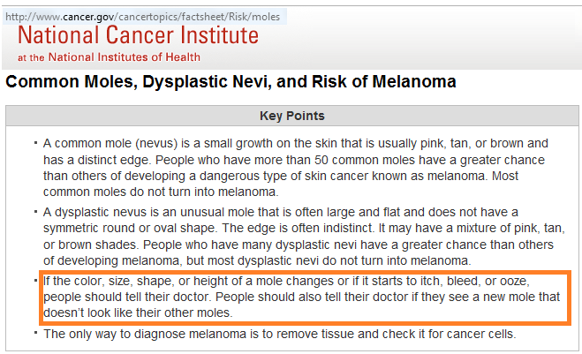
Itchy or bleeding moles
Globally, about 19% of all cancers were estimated to be attributable to the environment, resulting 1.3 million deaths each year.
Notes:
Presentations are a powerful communication medium.

Slide 24
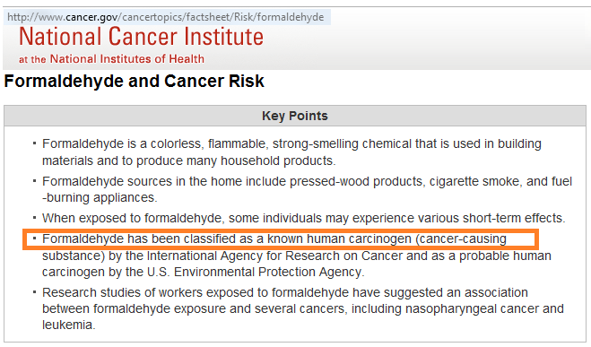
Formaldehyde
Globally, about 19% of all cancers were estimated to be attributable to the environment, resulting 1.3 million deaths each year.
Notes:
Presentations are a powerful communication medium.

Slide 25
Plastics – Where & how to avoid?
Mobile phones, radiation..
Are we safe with these…
Notes:
Presentations are a powerful communication medium.

Slide 26
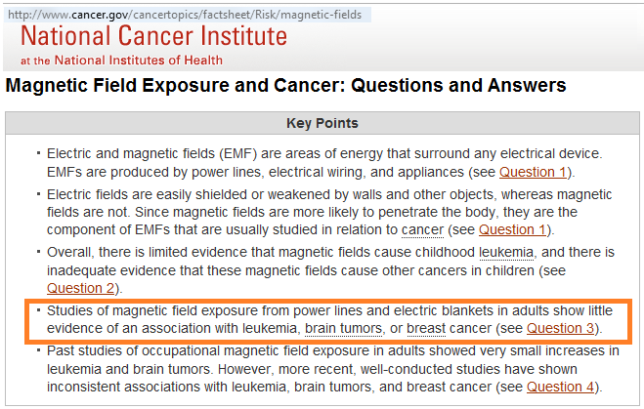
Electric and Magnetic field exposure
Globally, about 19% of all cancers were estimated to be attributable to the environment, resulting 1.3 million deaths each year.
Notes:
Presentations are a powerful communication medium.

Slide 27
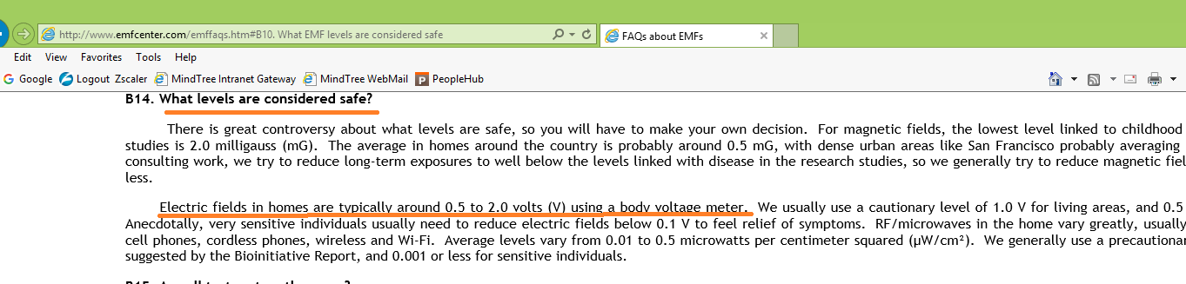
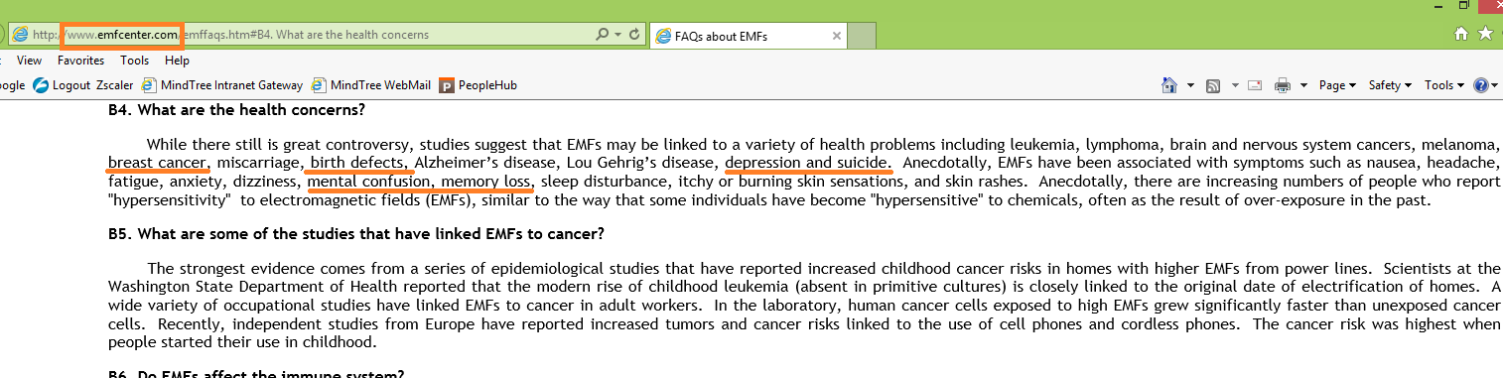

Slide 28
Plastics – Where & how to avoid?
Experiment..
Notes:
Presentations are a powerful communication medium.

Slide 29
Plastics – Where & how to avoid?
Remedy…
Keep Away and maintain Safe Distance from the device
Notes:
Presentations are a powerful communication medium.

Slide 30
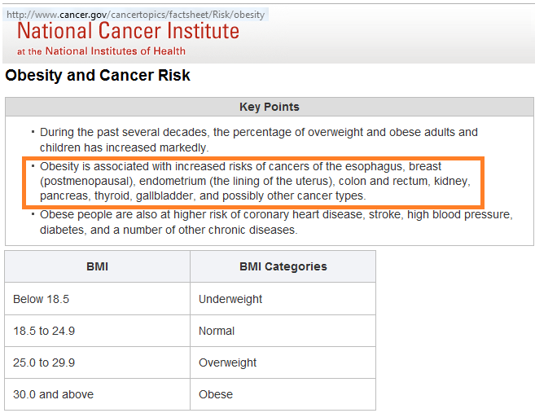
Obesity
Globally, about 19% of all cancers were estimated to be attributable to the environment, resulting 1.3 million deaths each year.
Notes:
Presentations are a powerful communication medium.

Slide 31
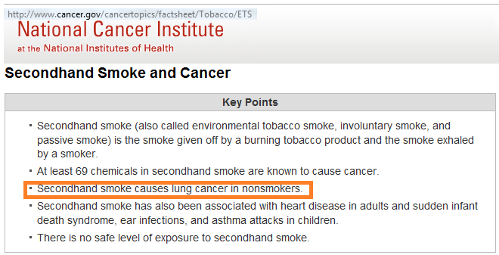
Secondhand smoking
Globally, about 19% of all cancers were estimated to be attributable to the environment, resulting 1.3 million deaths each year.
Notes:
Presentations are a powerful communication medium.

Slide 32
What type of person you are?
Globally, about 19% of all cancers were estimated to be attributable to the environment, resulting 1.3 million deaths each
Awareness, Alertness, Assertiveness on Consumables and toxicity
Avoid Plastics, Toxic Food and toxic consumables
Acceptance towards nature/non-toxic alternatives (with limitations)
Adopting good and active Lifestyle
Consumer type A
(Aware, Active)
Seek more information and not sure to change
Needs strong evidences and effects
Will have sluggishness towards change
Need to provide more accessibility and examples for change
Consumer type B
(Biased)
Not bothered and lazy
Give lame excuses and instances to counter
Thinks that we cannot change all these things and it may be costly
Thinks that “This is how things work, we never had problem”
Blames others
Consumer type C
(Careless, Cost conscious)
Notes:
Presentations are a powerful communication medium.

Slide 33
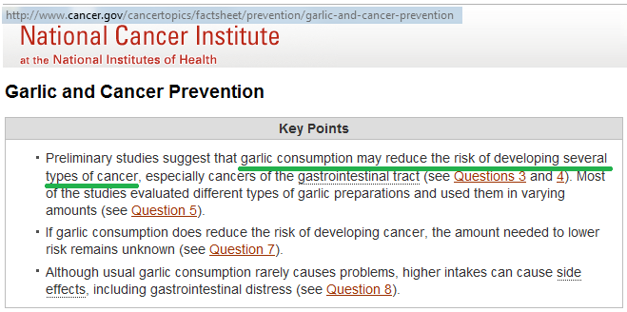
Garlic & Cancer Prevention
Globally, about 19% of all cancers were estimated to be attributable to the environment, resulting 1.3 million deaths each
Notes:
Presentations are a powerful communication medium.

Slide 34
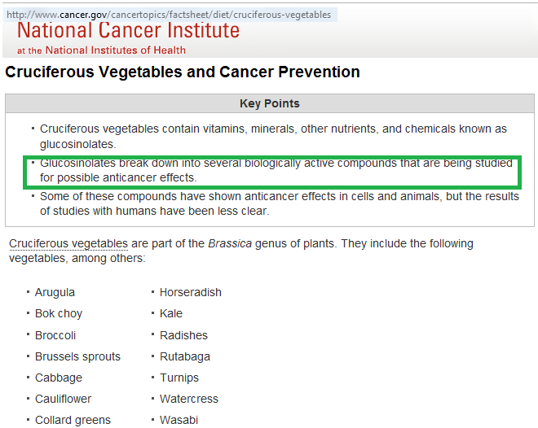
Vegetables & Cancer Prevention
Globally, about 19% of all cancers were estimated to be attributable to the environment, resulting 1.3 million deaths each
Notes:
Presentations are a powerful communication medium.

Slide 35


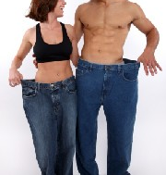
Prevention against Cancer
Be Active Physically and Mentally
Lead stress free life
Fruits
grains
vegetables
proteins
Be as lean as possible (watch for right BMI)
Eat Right Food
Notes:
Presentations are a powerful communication medium.

Slide 36




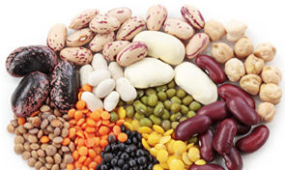
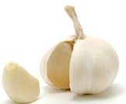



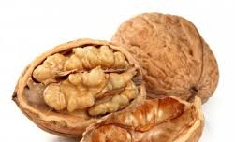
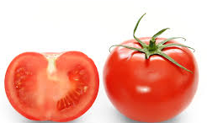

Globally, about 19% of all cancers were estimated to be attributable to the environment, resulting 1.3 million deaths each
Food that fights against Cancer
Apples
Cabbage, Broccoli
(Cruciferous)
Cherries
Greens, Lettuce, Spinach. Dark green leafy veggies.
Dry Beans, Soy & Peas (legumes)
Garlic
Grape & Grape juice
Green tea
Whole Grains (millets & unpolished)
Walnut
Grape & Grape juice
Soy
Notes:
Presentations are a powerful communication medium.

Slide 37
Plastics – Where & how to avoid?
Globally, about 19% of all cancers were estimated to be attributable to the environment, resulting 1.3 million deaths each year.
Excellent Dental Care
Notes:
Presentations are a powerful communication medium.

Slide 38
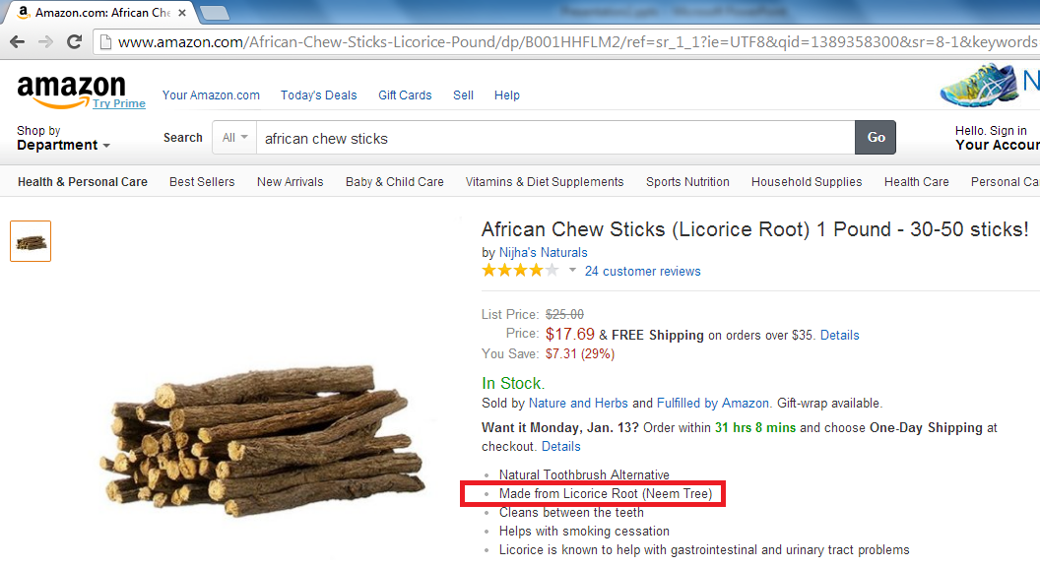

Slide 39
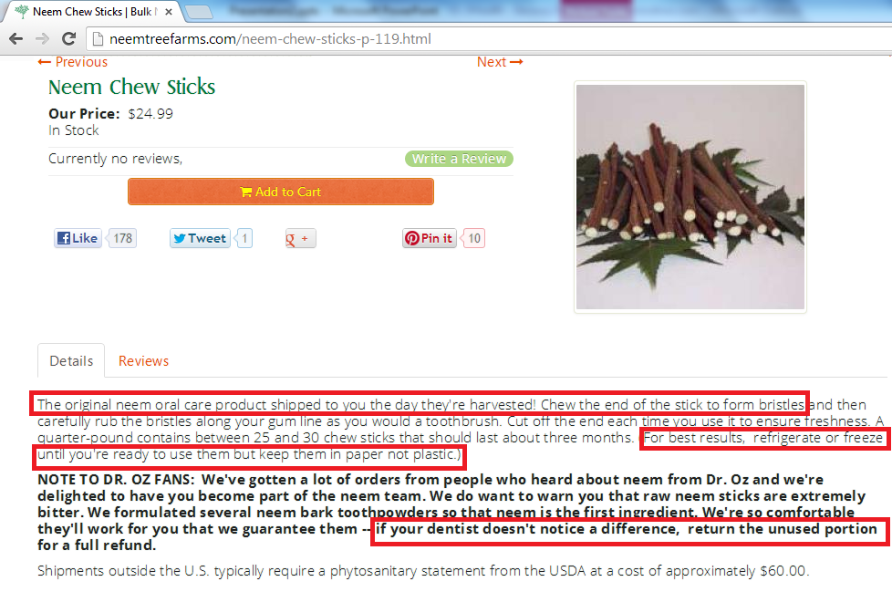

Slide 40
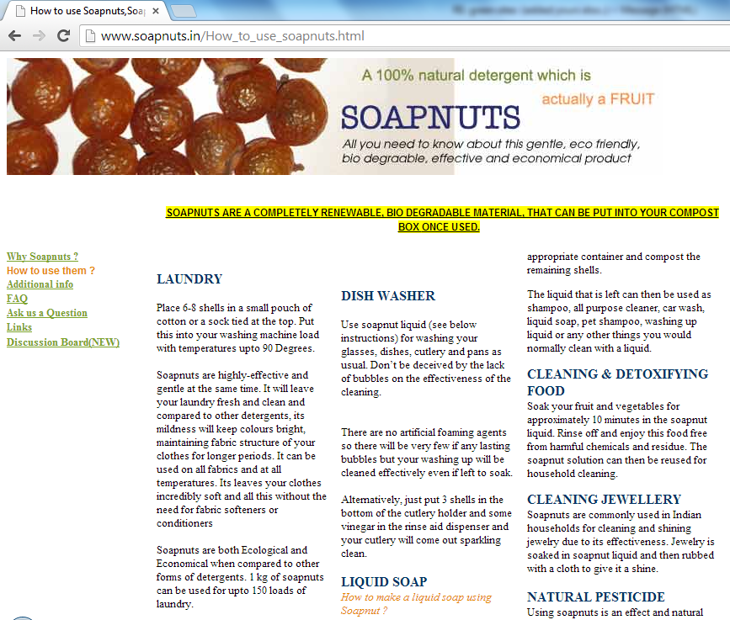


Slide 41
News Beware..

Slide 42

Toothpaste
Globally, about 19% of all cancers were estimated to be attributable to the environment, resulting 1.3 million deaths each year.
Notes:
Presentations are a powerful communication medium.

Slide 43

Milk
Globally, about 19% of all cancers were estimated to be attributable to the environment, resulting 1.3 million deaths each year.
Notes:
Presentations are a powerful communication medium.

Slide 44

Biscuits
Globally, about 19% of all cancers were estimated to be attributable to the environment, resulting 1.3 million deaths each year.
Notes:
Presentations are a powerful communication medium.

Slide 45

Fluorides
Globally, about 19% of all cancers were estimated to be attributable to the environment, resulting 1.3 million deaths each year.
Notes:
Presentations are a powerful communication medium.

Slide 46

Water Contamination
Globally, about 19% of all cancers were estimated to be attributable to the environment, resulting 1.3 million deaths each year.
Notes:
Presentations are a powerful communication medium.

Slide 47


A man dies every 17 mins due to Prostrate Cancer
Globally, about 19% of all cancers were estimated to be attributable to the environment, resulting 1.3 million deaths each year.
Notes:
Presentations are a powerful communication medium.

Slide 48
Who can help us to be safe???

Slide 49
How to spread the message to our next generation???

Slide 51

video

Slide 52
Are You An Ignorant
Victim??
Ask more Questions and adopt right habits

Slide 53
Thanks..
The last take away..

